Slide 1

PRESENTED BY
FA22-BCS-203
Sana Shaheen

Slide 2

ORACLE VIEW
In Oracle, the view is a virtual table that does not physically exist. .
It is stored in an Oracle data dictionary and do not store any data.
It can be executed when called.
A view is created by a query joining one or more tables.

Slide 3
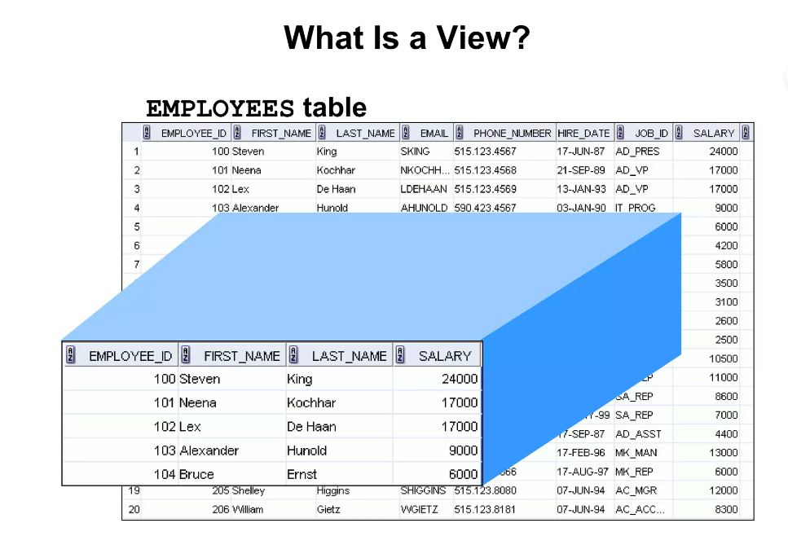

Slide 4
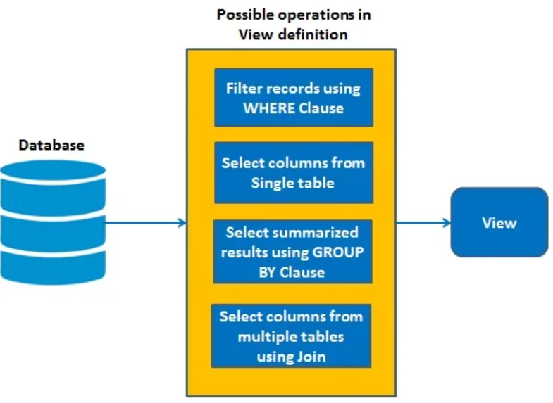

Slide 5

SYNTAX
ORACLE CREATE
VIEW
CREATE VIEW view_name AS SELECT columns
FROM tables
WHERE conditions;

Slide 6
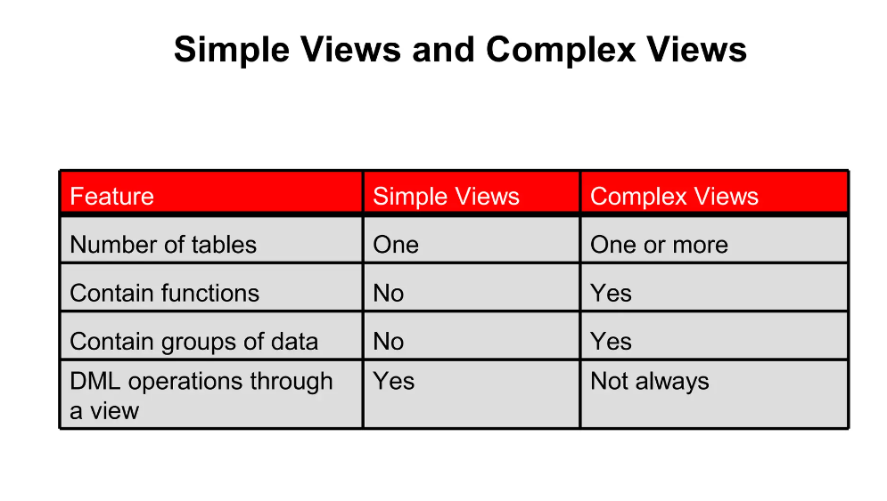

Slide 7

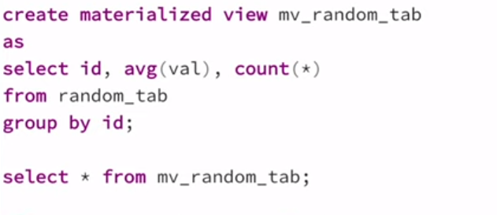
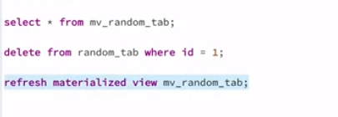
MATERIALIZED VIEW
Like a physical table that stores query output or intermediate results
Holds data

Slide 8
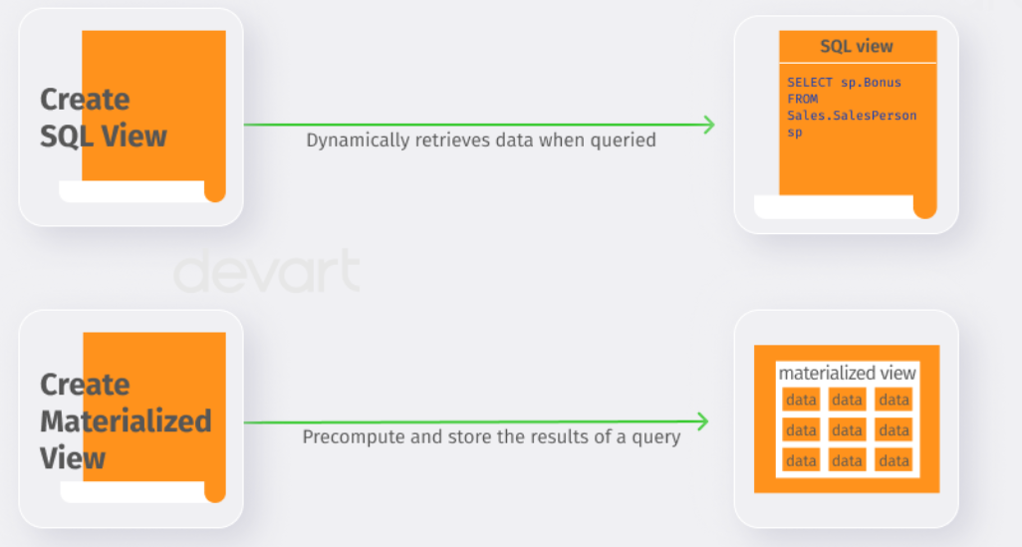

Slide 9
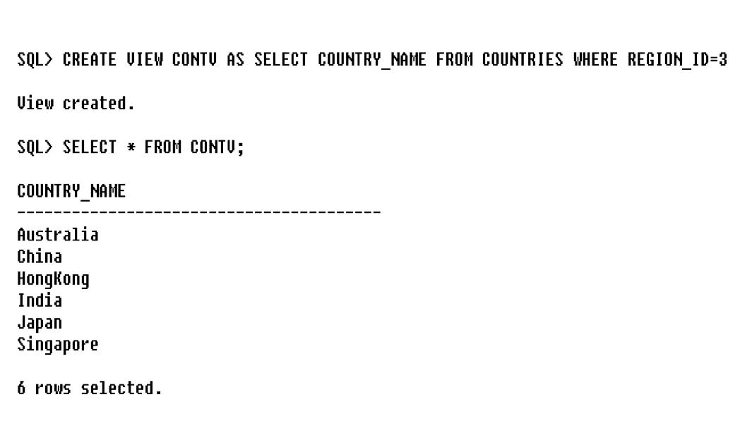
SIMPLE VIEW

Slide 10
SYNTAX
ORACLE UPDATE VIEW
In Oracle, the CREATE OR REPLACE VIEW statement is used to modify the definition of an Oracle VIEW without dropping it.
CREATE OR REPLACE VIEW view_name AS
SELECT columns
FROM table
WHERE conditions;

Slide 11
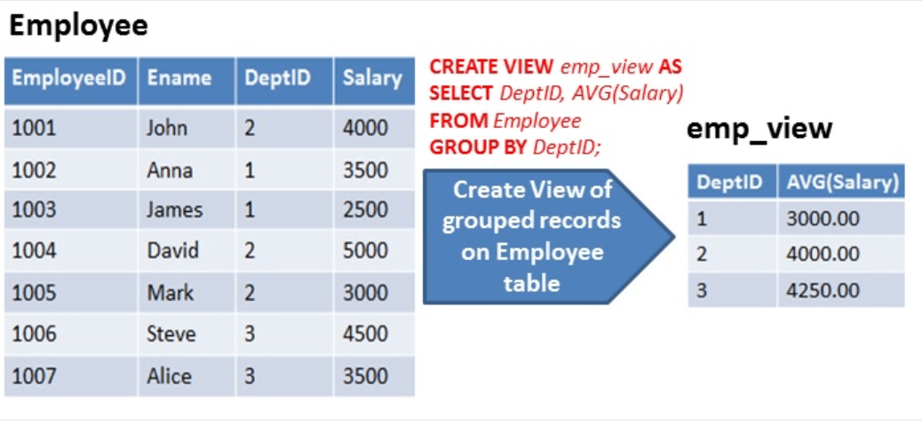
COMPLEX VIEW

Slide 12
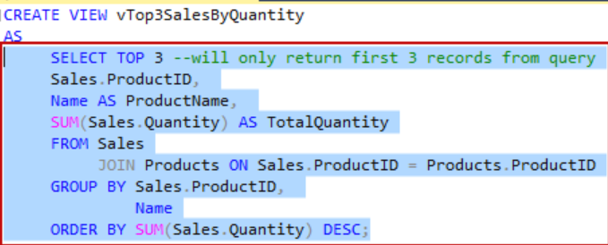
COMPLEX VIEW ON TWO TABLES

Slide 13
ORACLE DROP VIEW
SYNTAX
The DROP VIEW statement is used to remove or delete the VIEW completely.
DROP VIEW view_name;

Slide 14
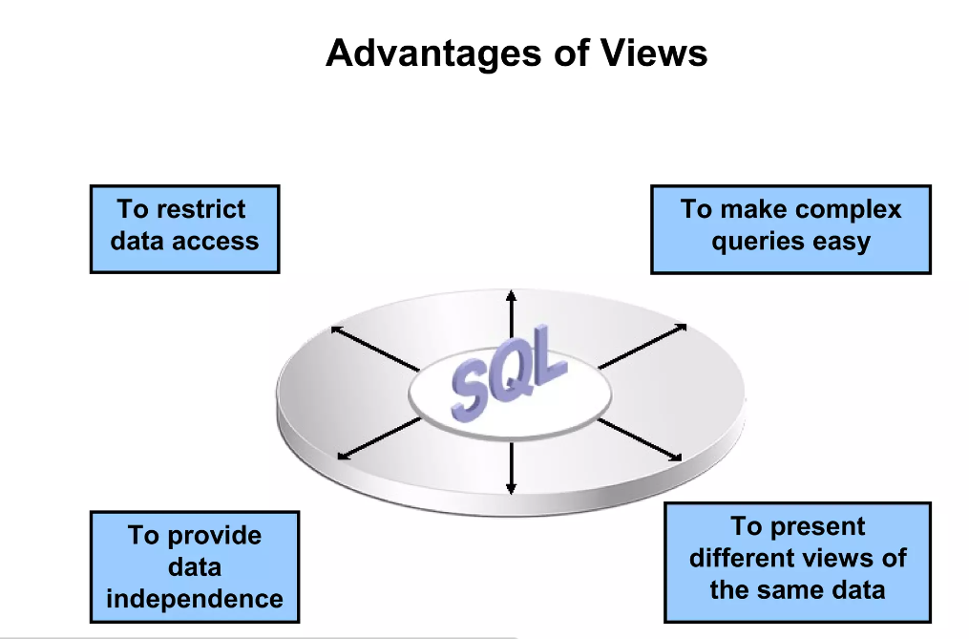
ADVANTAGES OF VIEWS

Slide 15
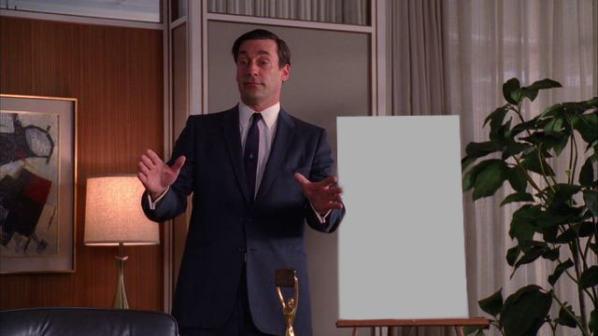
OFFICIALLY MY PRESENTATION HAS ENDED!!!!
ANY QUESTIONS??IF NOT JUST CLAP
IF THERE IS, THEN ASK THE TEACHER

